Slide 1
Real-time data and affordable housing: what will it take to end homelessness? A nordic and EU perspective
May 2026

Slide 2

Introducing NHA
Notes:
Add: what do we talk about when we talk about homelessness? Definitions?

Slide 3
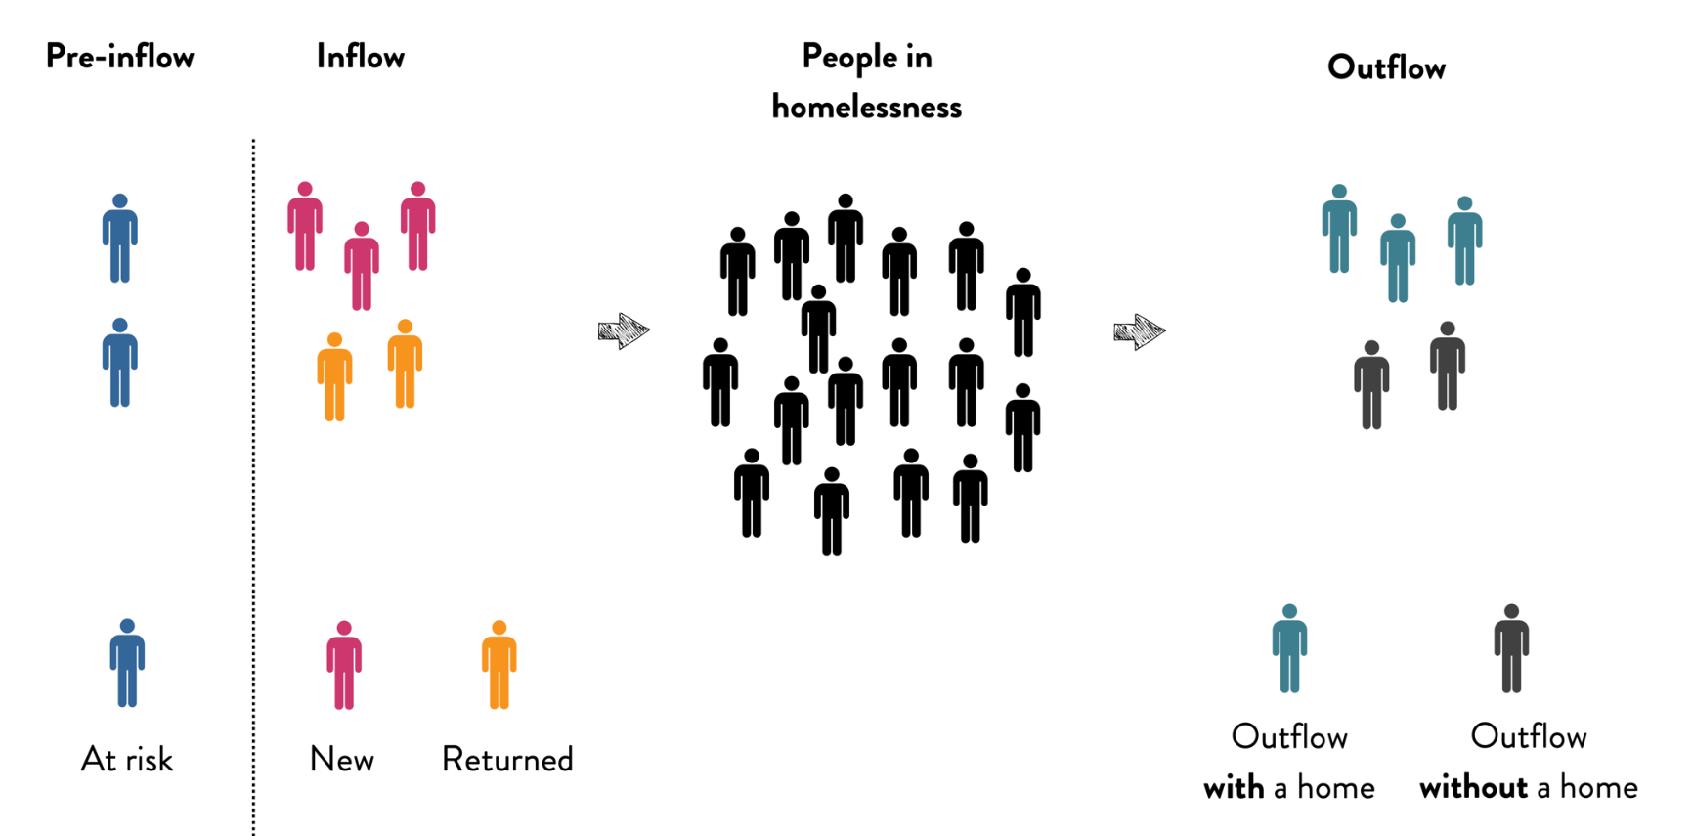
Real-time data in Kolding, Denmark

Slide 4

Real-time data in Kolding, Denmark
m

Slide 5

Real-time data in Kolding, Denmark

Slide 6
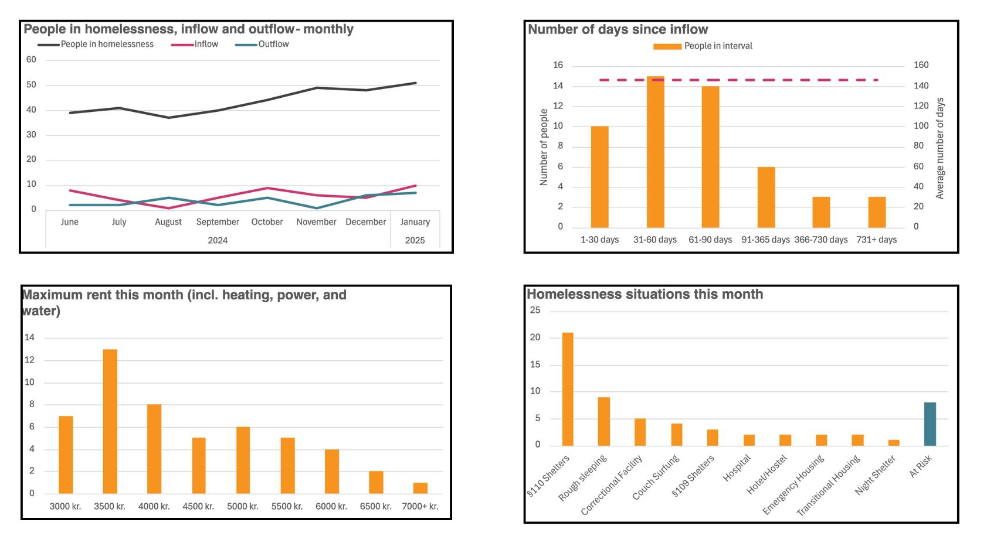
Real-time data in Kolding, Denmark

Slide 7
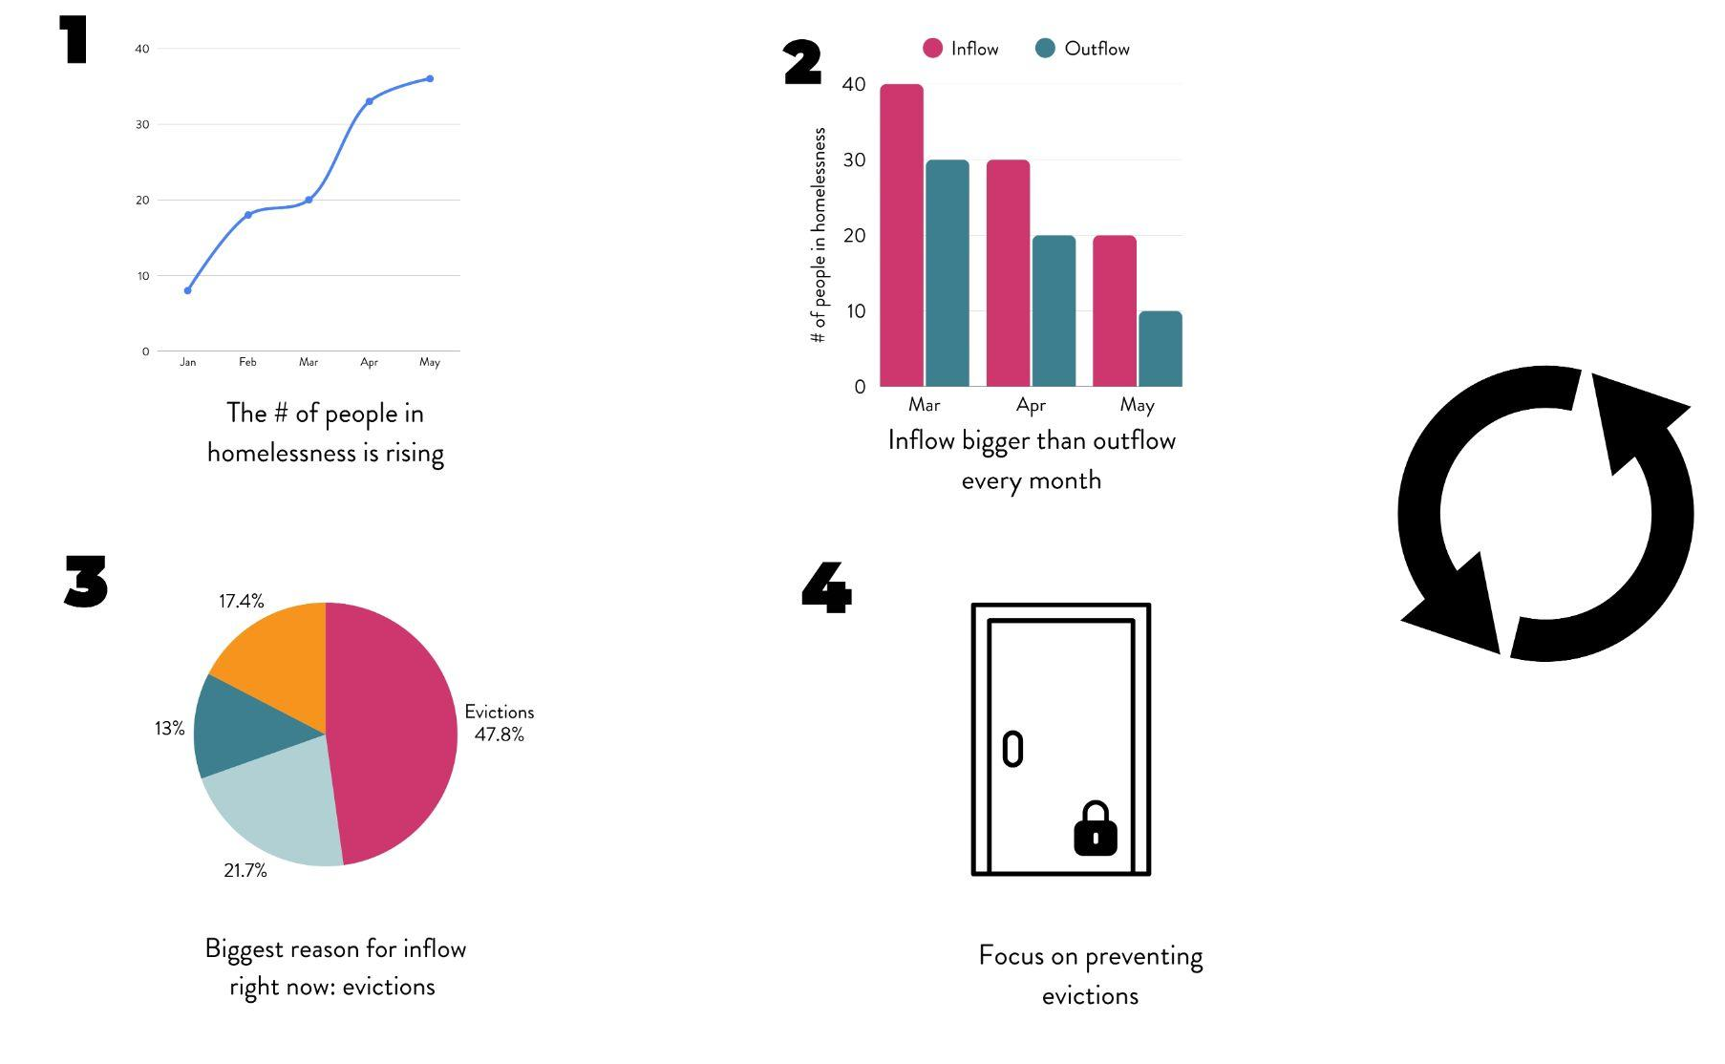
Real-time data in Kolding, Denmark

Slide 8
Key takeaways and learnings from Kolding
Real-time data is the tool – not the goal
It takes effort – but it is possible

Slide 9
EU perspective (1)
EU momentum on homelessness
Policy frame
- EU Affordable Housing Plan (12/2025)
- EU Anti-Poverty Strategy (5/2026)
- Council Recommendation on homelessness & housing exclusion (5/2025)
Delivery tool
- EU Platform on Combatting Homelessness (6/2021)
. All 27 Member states!
. Agreed to cooperate at European level
Funding
- Multi-annual financial framework 2028 – 2035
. Homelessness explicit objective
. 5% of social money ringfenced ?!

Slide 10
EU perspective (2)
EU Objective
- Make progress toward ending homelessness (by 2030) & solving it (by 2050)
Monitoring & data collection is key
- Workstream of EPOCH
- Power of comparison
What exist?
- Life time experience of homelessness (Eurostat)
2023 : EU 5% - Nordic (10%)
Irrelevant…
- Point in time : population census 2021 (Eurostat)
SE, & NO:0 / FI: 65.000 / DK: 6700/ ICE: 2800
Inaccurate…
- Point in time : on basis of existing data in MS & extrapolation (FEANTSA)
1.3 million
Incomplete…
Need to fill the gap
- Real-time data… ?!

Slide 11





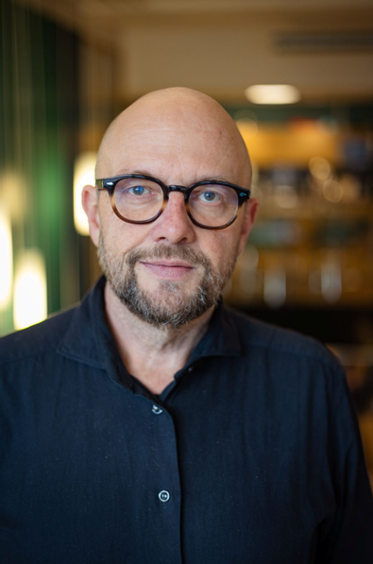


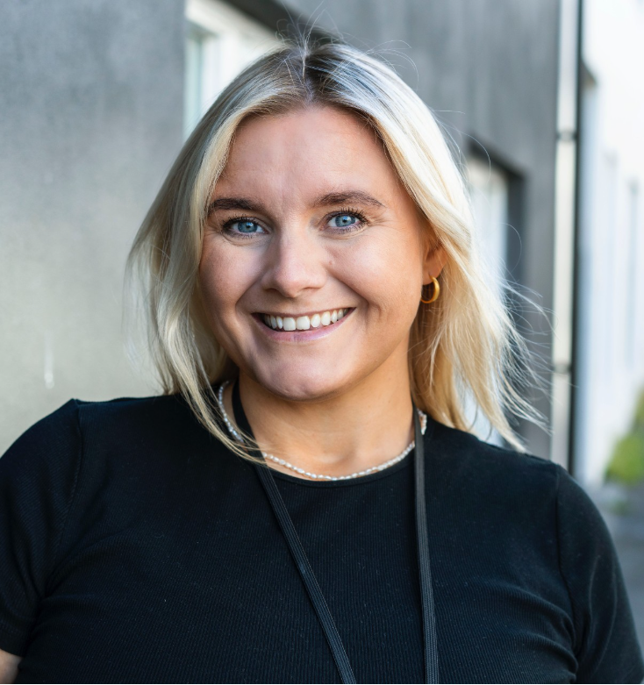
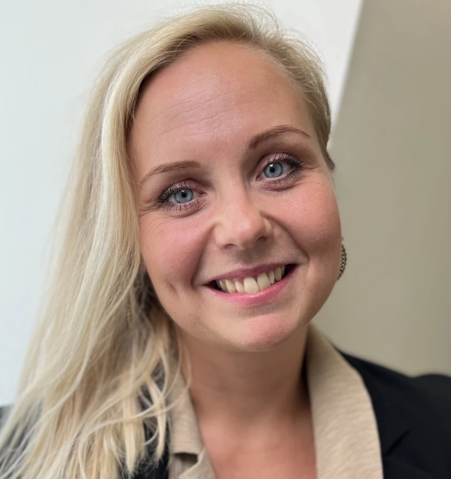
Panel
Louise Marie Pedersen
Founder & Director - Hjemløsninger
Soffía Hjördís Ólafsdóttir
Head of Department for People in homelessness with Extensive and Complex Service Needs - City of Reykjavik
Hermund Urstad
Senior Advisor Husbanken Department for Research and Analysis
Vilja Kampila
Senior Specialist
Centre for State-Subsidised Housing Construction, Ministry of the Environment
Marcus Knutagård
Head of Department and professor at the Department of Urban Studies, Malmö University
Notes:
Moderation:
Max 30–45 seconds per speaker
Push:
“Is this mainly a question of political will?”

Slide 12
THE NORDIC HOMELESSNESS COLLABORATION SERIES
Learning journey for Nordic professionals working with Housing First and homelessness. This three-part series brings together a small group of practitioners from across the Nordic countries to deepen expertise, exchange practices, and build lasting collaboration. Through in-person meetings, discussions, and site visits, participants will explore key themes in homelessness work and learn from real-life examples across the region.

