Slide 1

Finding common ground in divided times
May 2026

Slide 2

Overview
A challenging and complex moment for leaders and societies
Understanding the ‘why’ to meet this moment
Reflections on how civil society effectively meet this moment
May 2026
Nordisk Stadsmissions konferens

Slide 3
1
A challenging and complex
moment for leaders
and societies

Slide 4





Dynamics of polarisation – division, distrust and distortion – are creating challenges for leaders in every part of our societies
Content creators navigating disinformation
Education leaders on navigating EDI culture wars
Healthcare leaders navigating vaccine skepticism
Police navigating collapsing institutional trust
Farmers in navigating culture war battles

Slide 5
This moment requires a different leadership skill set that isn’t always instinctive
Identifying false
binaries
Uncovering perception
gaps
Finding unexpected common ground
Elevating the voices of ordinary people

Slide 6
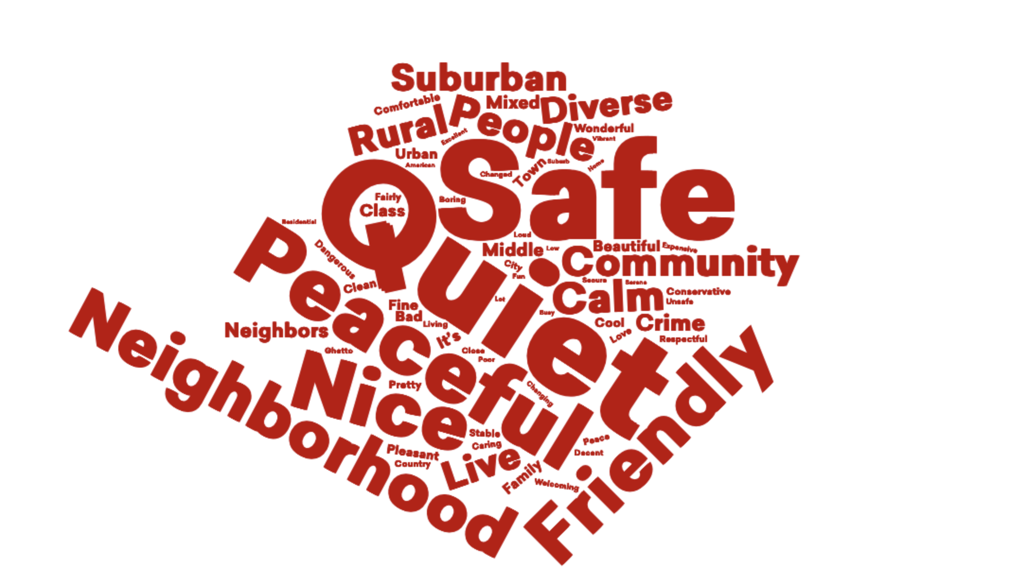

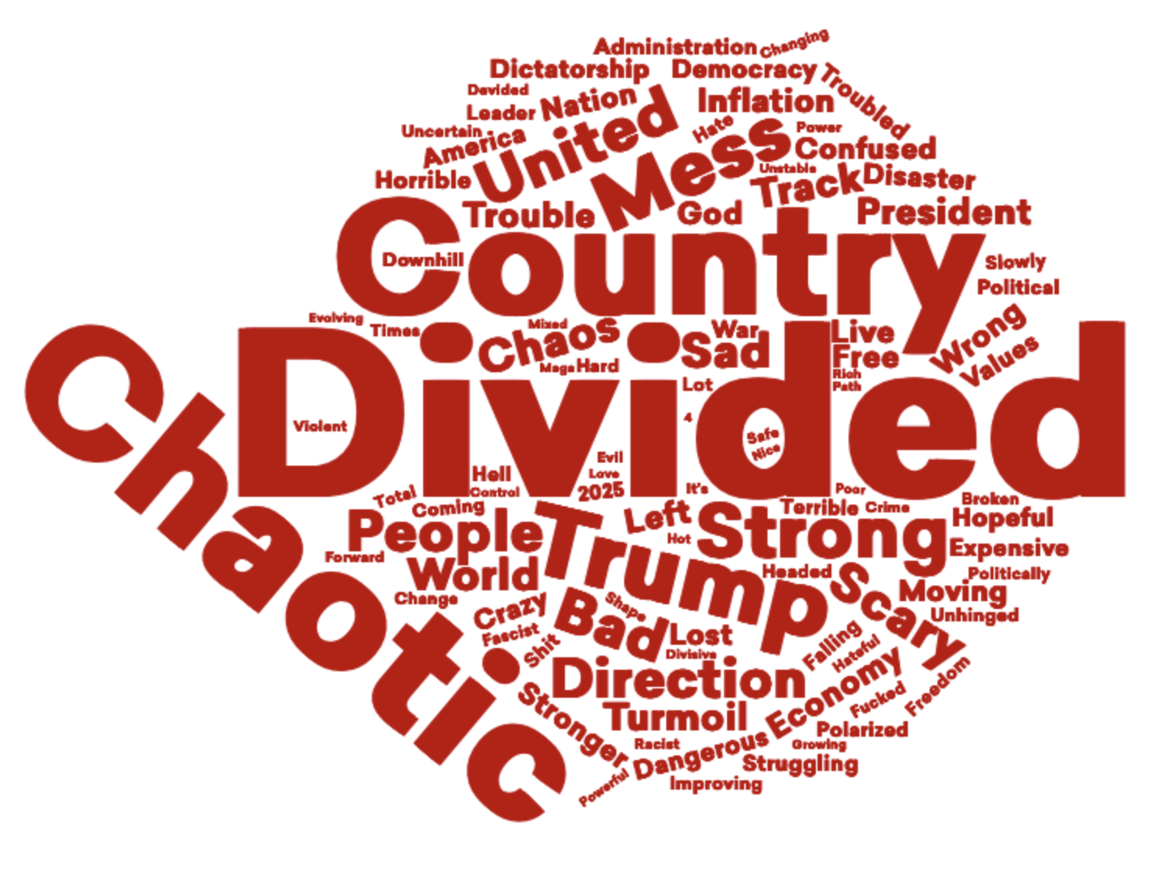
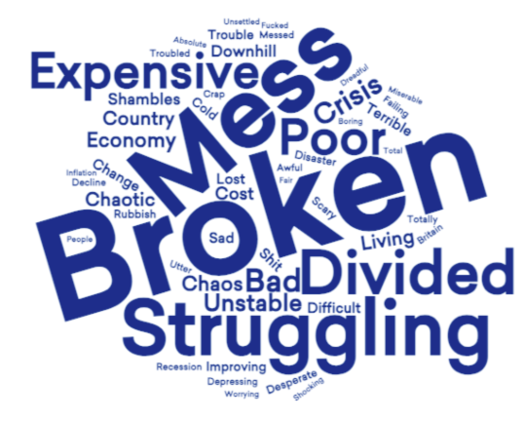
Local vs national conditions: people find sources of identity locally that unite across lines of difference
In one or two words, how would you describe your local community today?
In one or two words, how would you describe the US/UK today?
November 2025
May 2026
Nordisk Stadsmissions konferens

Slide 7
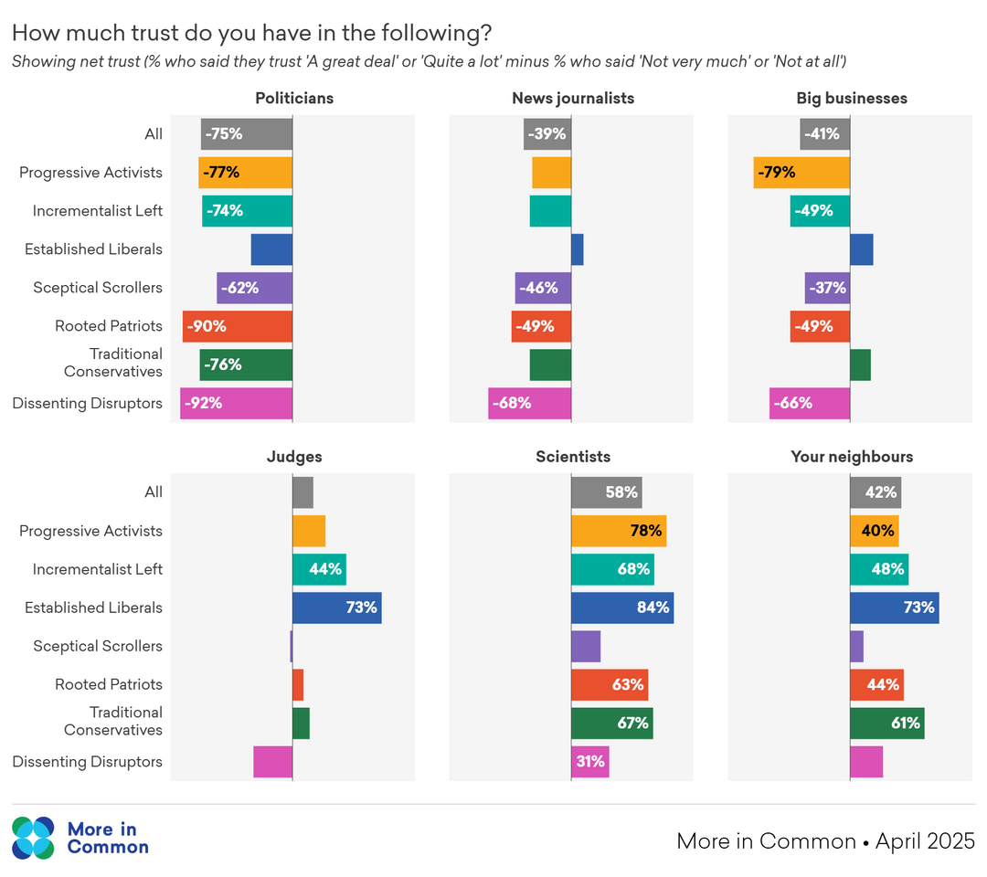
Vertical trust is eroding in many leaders across society
However, horizon trust in neighbors remains fairly resilient
May 2026
Nordisk Stadsmissions konferens

Slide 8
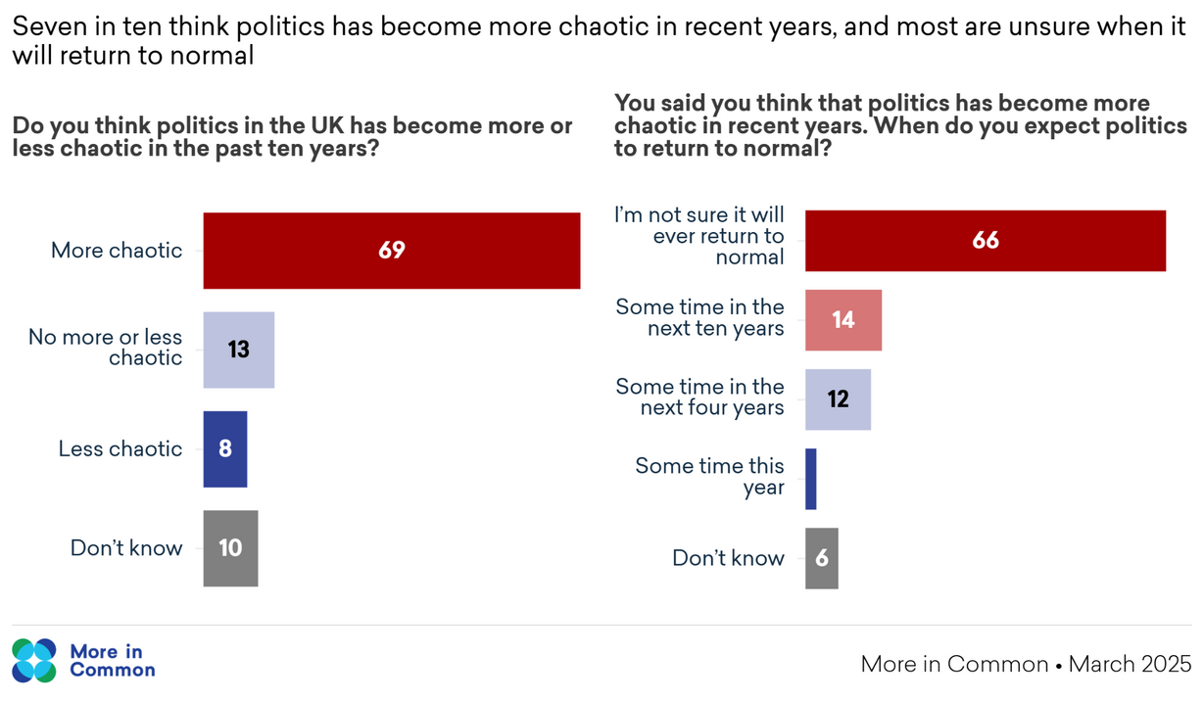
Exhaustion with politics
The public is tired with the conflict and chaos of politics and a sense of permanent crisis
May 2026
Nordisk Stadsmissions konferens

Slide 9
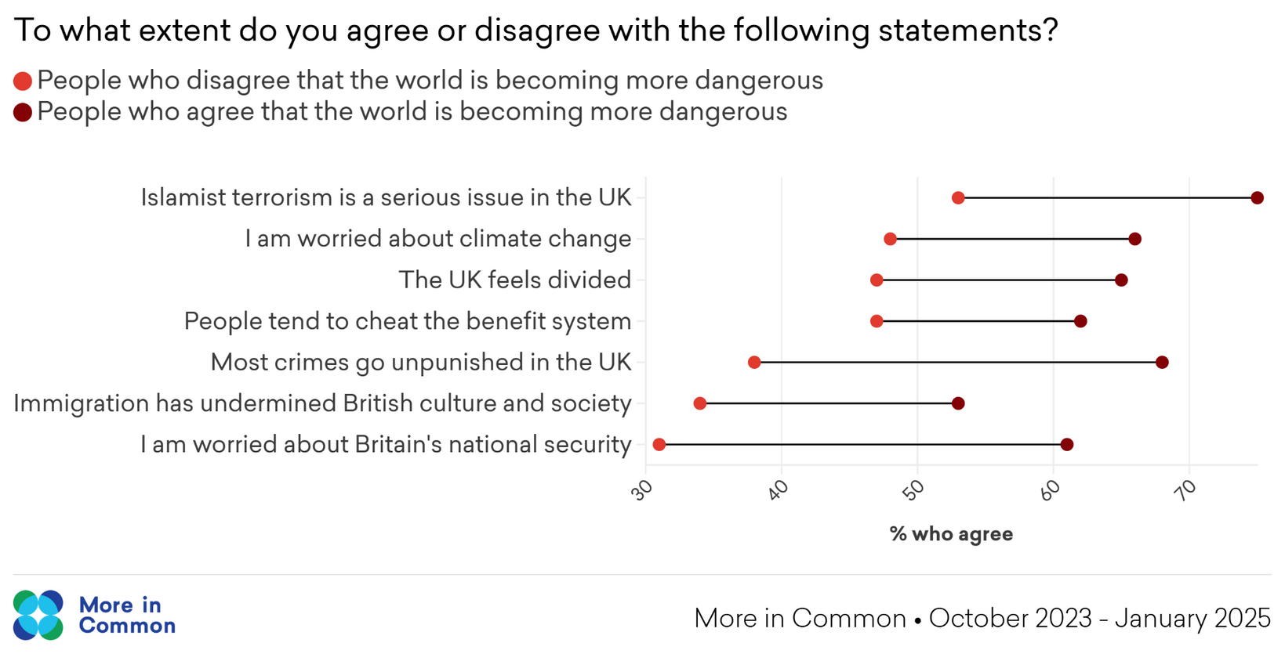
High levels of threat perception shape broader outlook on the healthy of our societies
May 2026
Nordisk Stadsmissions konferens

Slide 10
A deepening sense of disconnection
Before Covid we all used to have lunch together, but since then we just sit in our cars and eat alone on our break
Clive, Crane driver, Dudley, England

Slide 11
55%
of Gen Z Britons say that life would be better if social media didn’t exist
Social media is compounding the crisis of disconnection

Slide 12
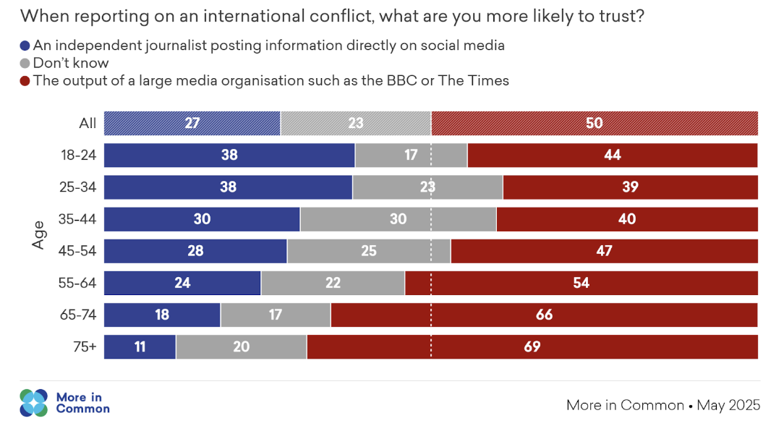
Declining influence of mainstream media with young people
May 2026
Nordisk Stadsmissions konferens

Slide 13
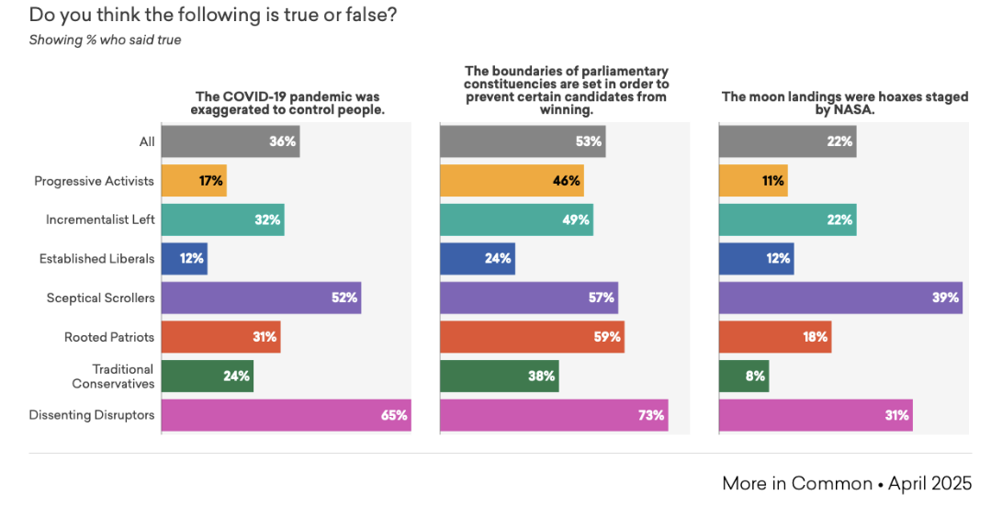
Rising conspiracy style thinking and falling trust in experts
May 2026
Nordisk Stadsmissions konferens

Slide 14
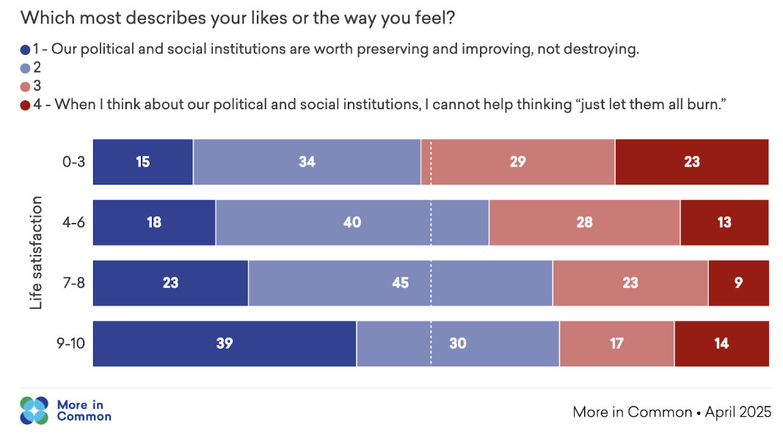
The appeal of ‘burn it all down’ sentiments
Two in five Britons think that institutions should be destroyed, not preserved.
May 2026
Nordisk Stadsmissions konferens

Slide 15
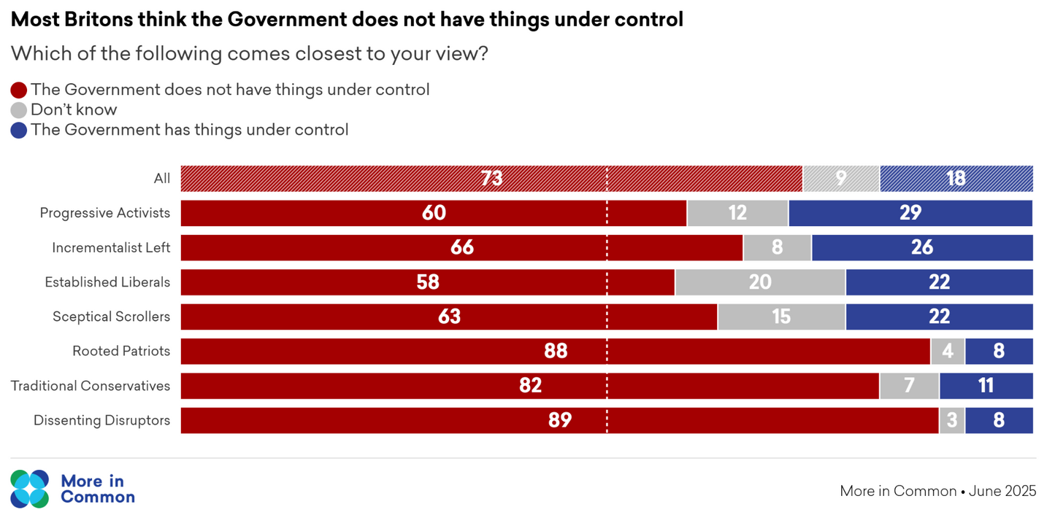
A loss of confidence in the capacity of both governments and individuals to effect change
May 2026
Nordisk Stadsmissions konferens

Slide 16
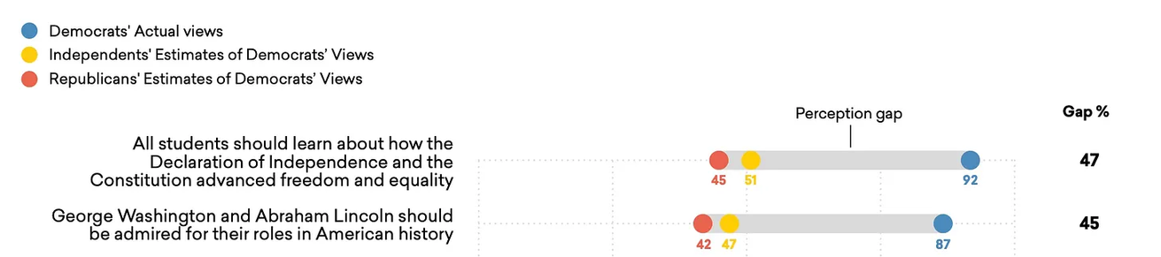
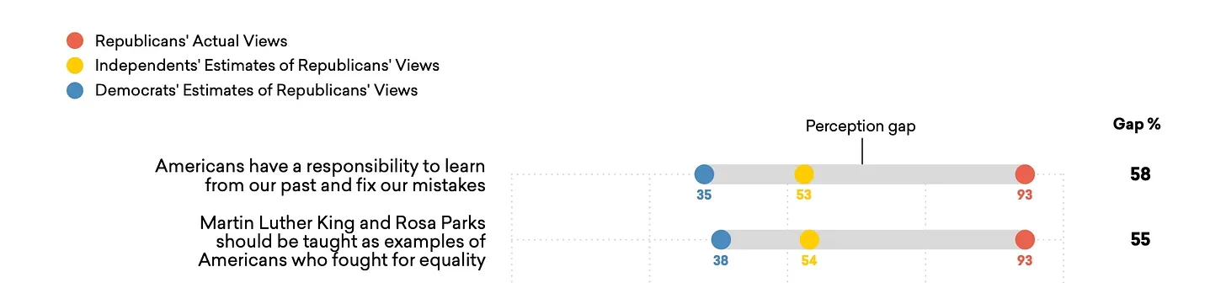
Democrats and Republicans perceptions gaps on US history
Perception gaps are increasing distrust in many of our societies
May 2026
Nordisk Stadsmissions konferens

Slide 17
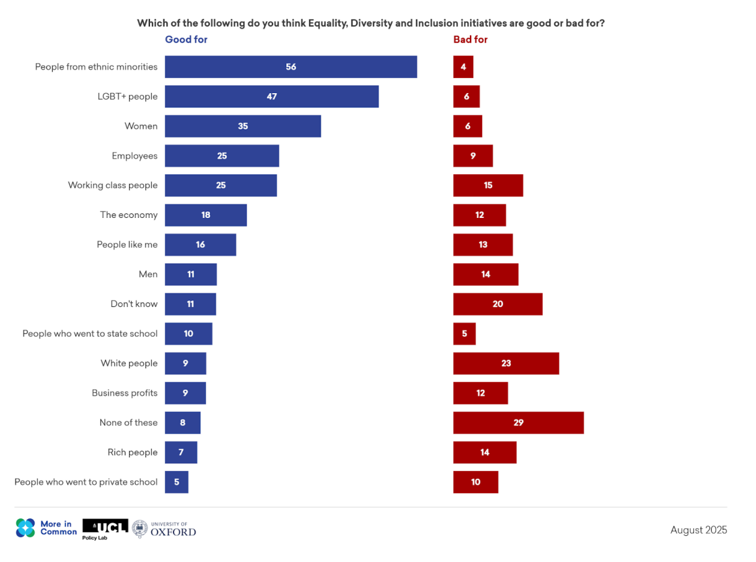
Zero-sum thinking is a challenge that faces societies across a whole range of issues
e.g. debates about diversity and immigration
May 2026
Nordisk Stadsmissions konferens

Slide 18
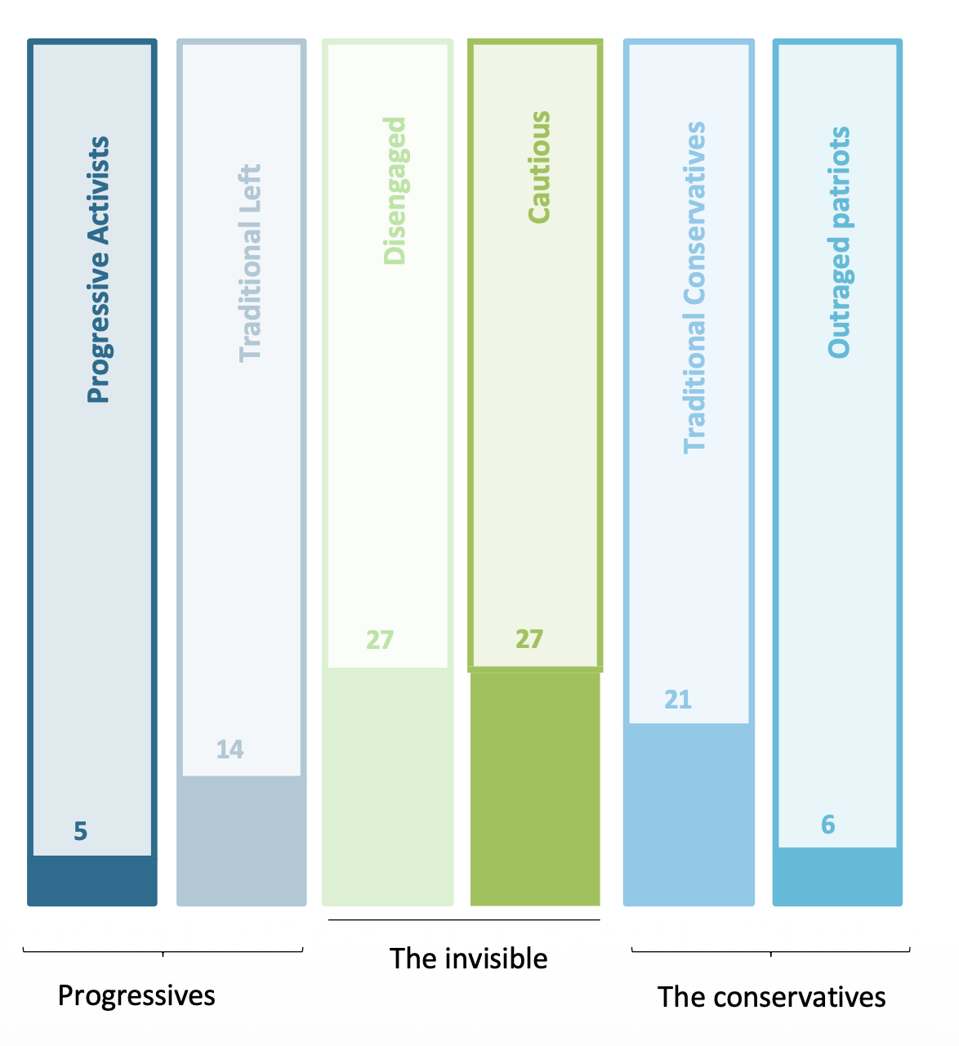
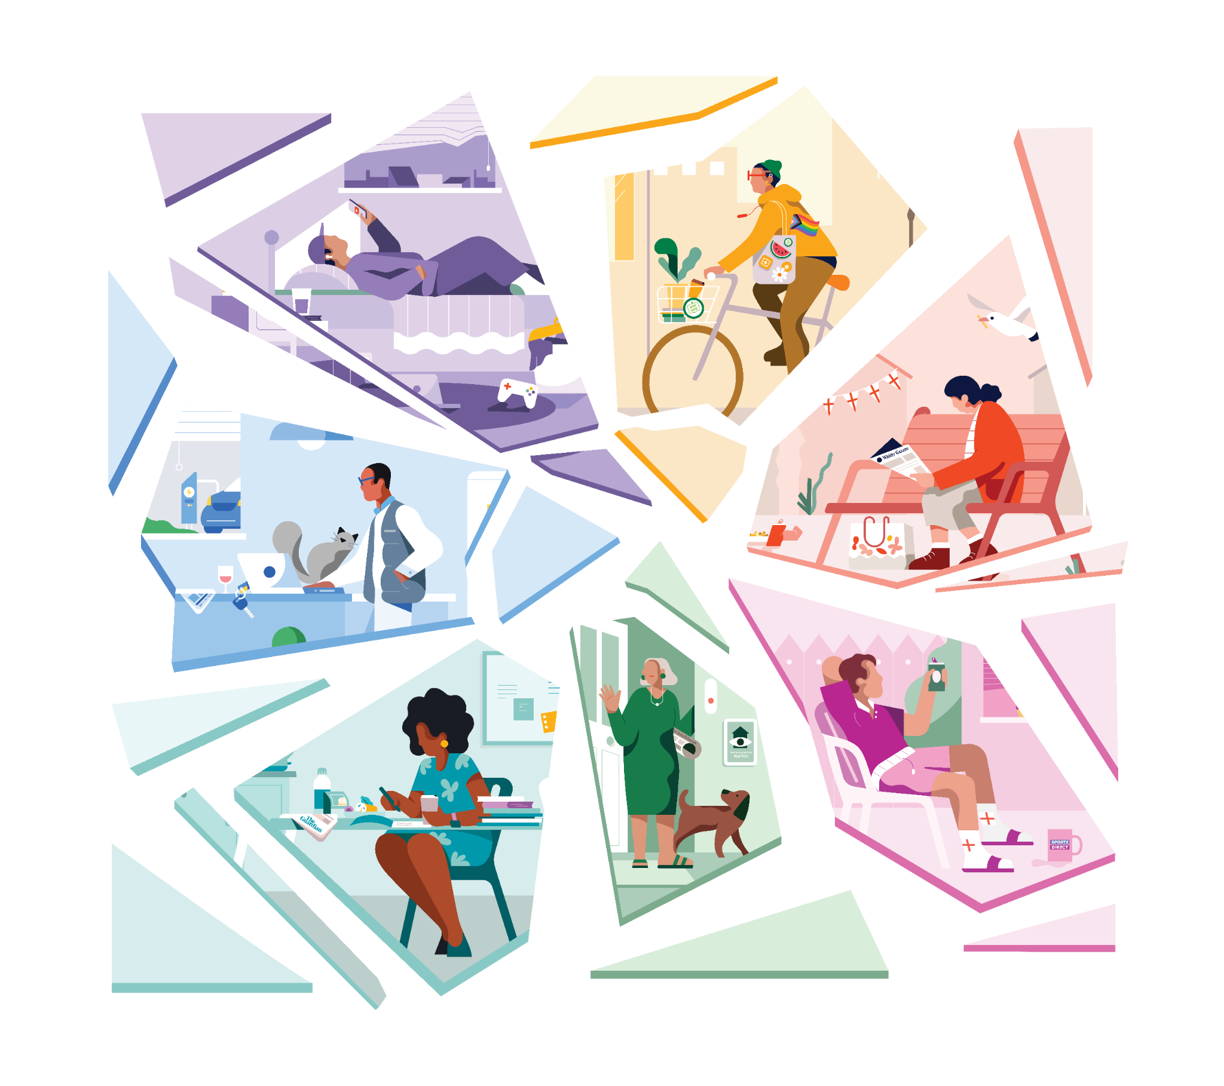
More in Common maps people’s values and identities to help people navigate these dynamics
Sceptical Scrollers
10% of the population
Progressive Activists
12% of the population
Rooted Patriots
20% of the population
Established Liberals
9% of the population
Dissenting Disruptors
20% of the population
Incrementalist Left
21% of the population

Slide 19
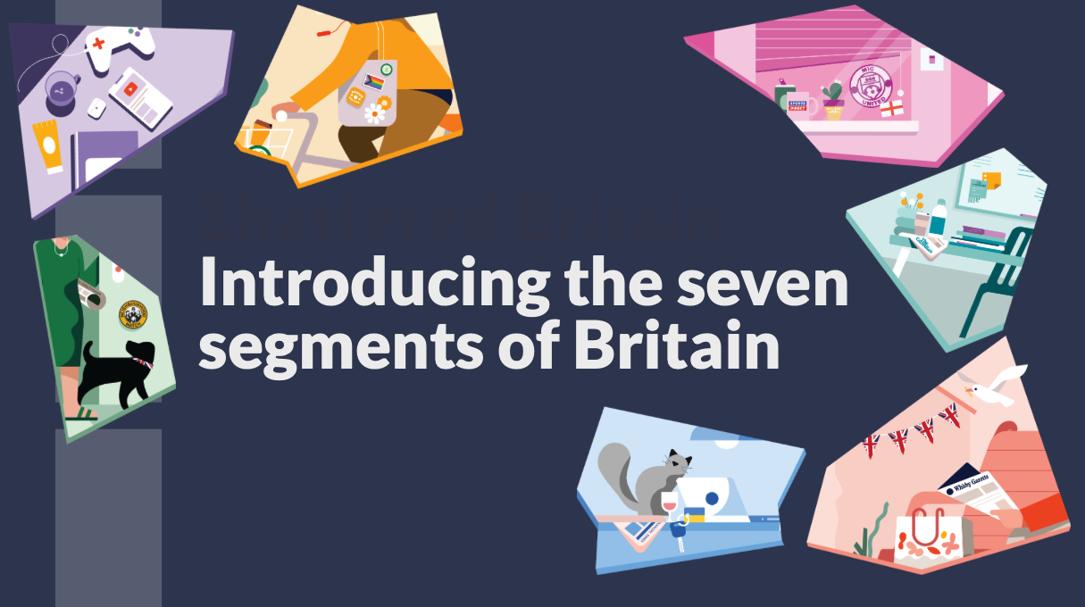

Slide 20
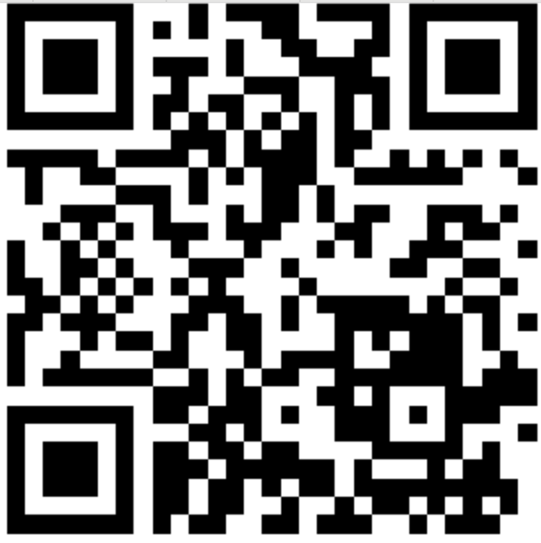
8 minutes – Take our British segmentation quiz
Huge Caveat:
This is the British Seven – fault lines and and segments vary between
Society
Beehive discussion: are these faultlines the same in the Nordics?

Slide 21
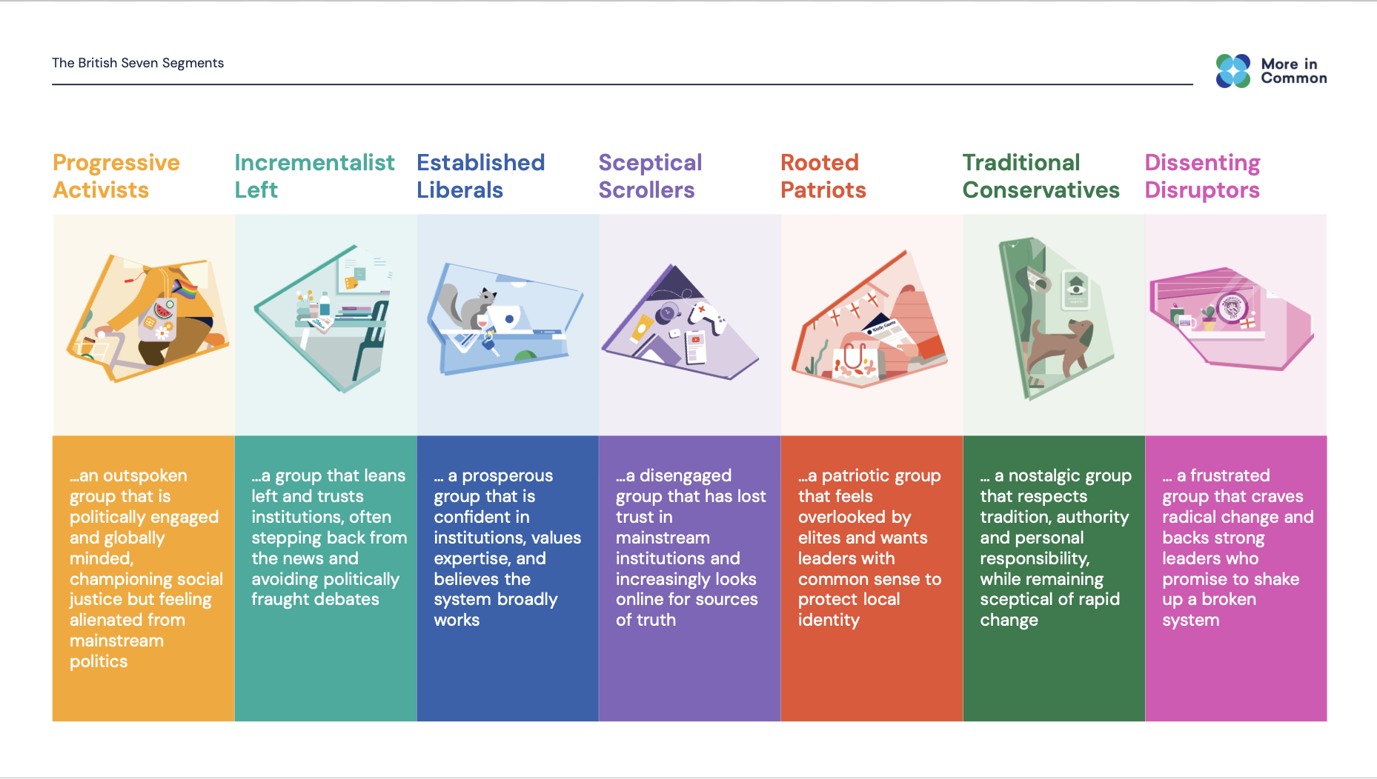

Slide 22
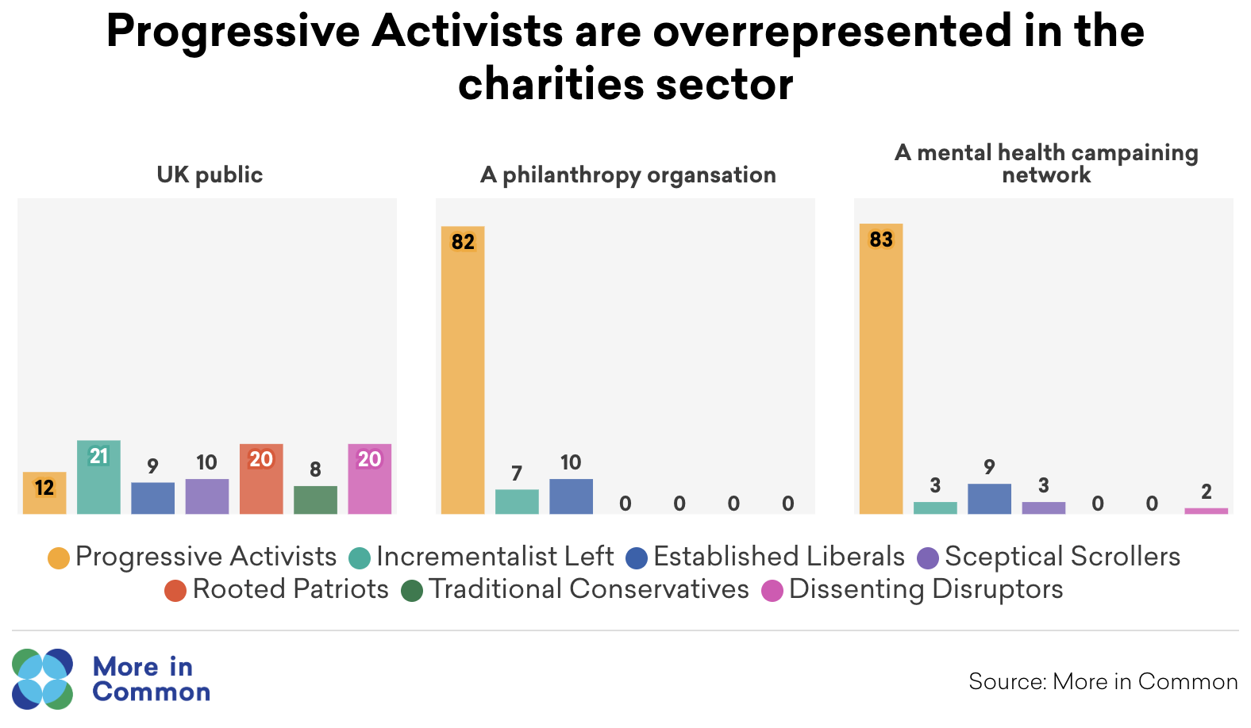
Progressive Activists are the most likely to say a job having a social purpose is important to them
May 2026
Nordisk Stadsmissions konferens

Slide 23
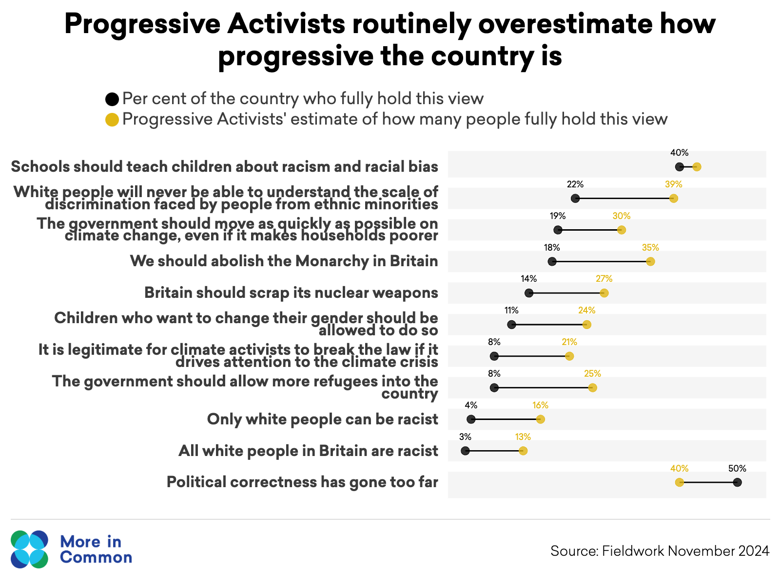
Progressive Activists tend to overestimate their level of support
May 2026
Nordisk Stadsmissions konferens

Slide 24
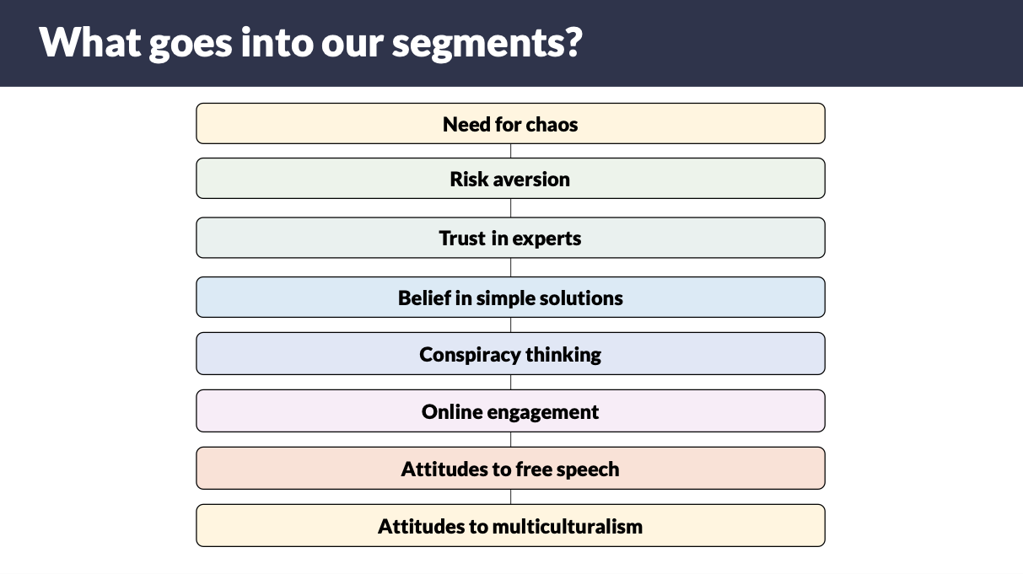

Slide 25
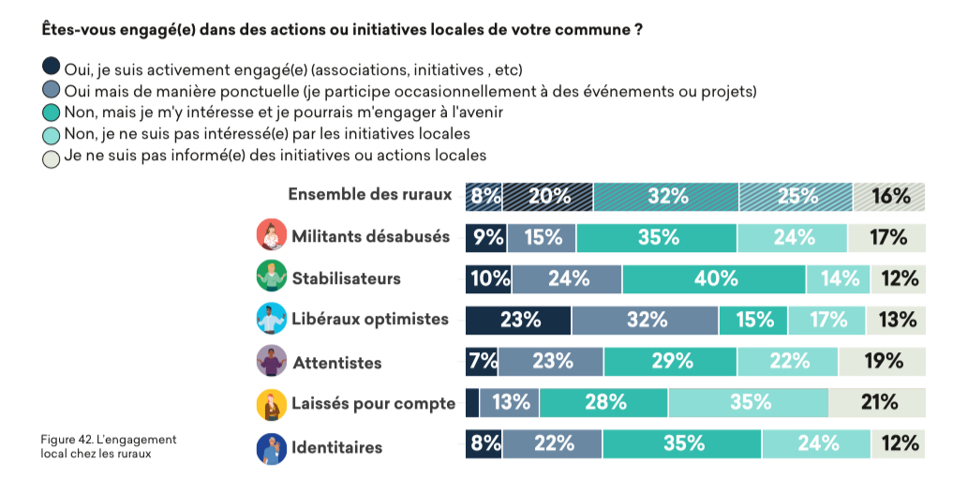
Our Six French Families helping understand civic engagement in rural France

Slide 26
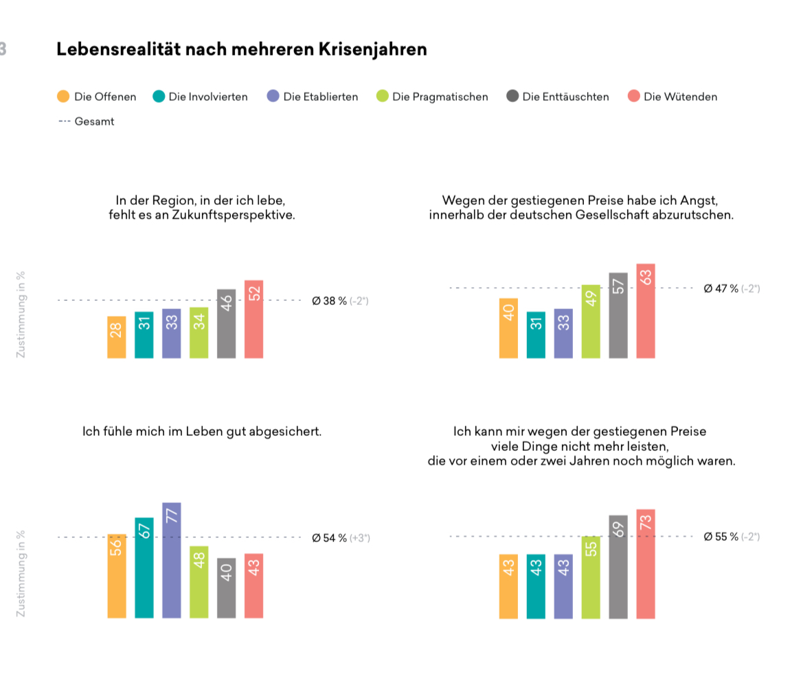
How the segments have dealt with the cost of living crisis
The six German segment explain growing disillusionment with Germany democracy e.g. the gap between the Established and the Angry
There are no prospects for the future in the region where I live
Because of the rise in price, I’m afraid of slipping within German society
I feel well protected in life
I can no longer afford many things that were still possible a year or two ago

Slide 27
2
How is More in Common
seeks to meet this moment

Slide 28
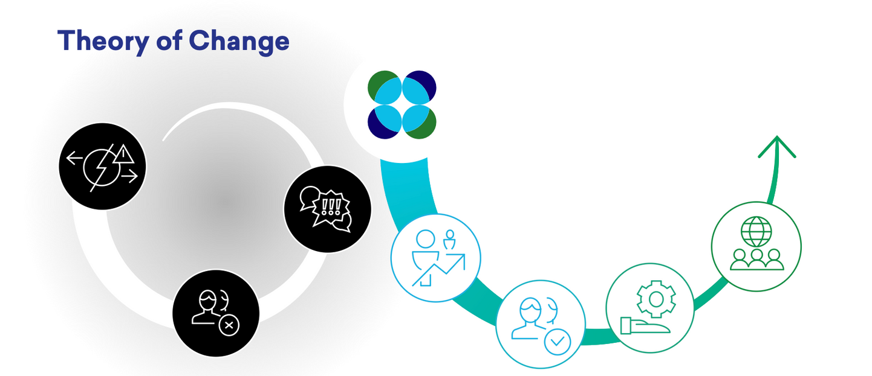
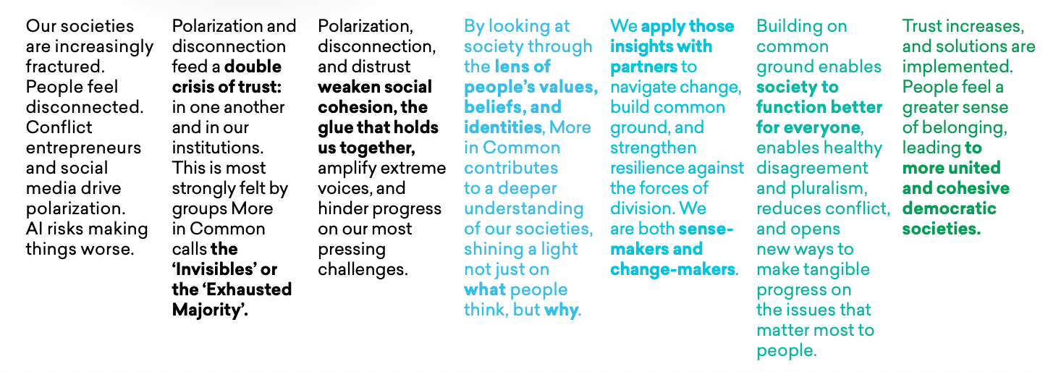
How More in Common meets the moment
Our theory of change
May 2026
Nordisk Stadsmissions konferens

Slide 29
The Connection Opportunity work

Slide 30
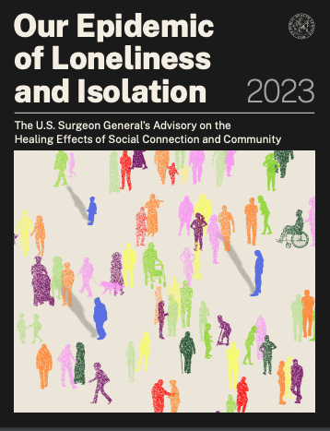
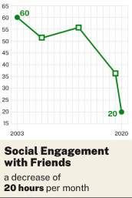
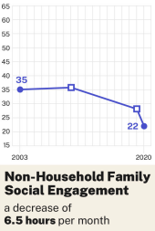
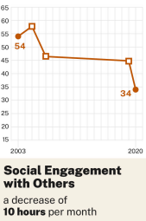
Behind many of America’s challenges is a crisis of connection
Annual Daily Average (min.)
Source: Office of the Surgeon General, 2023
30

Slide 31


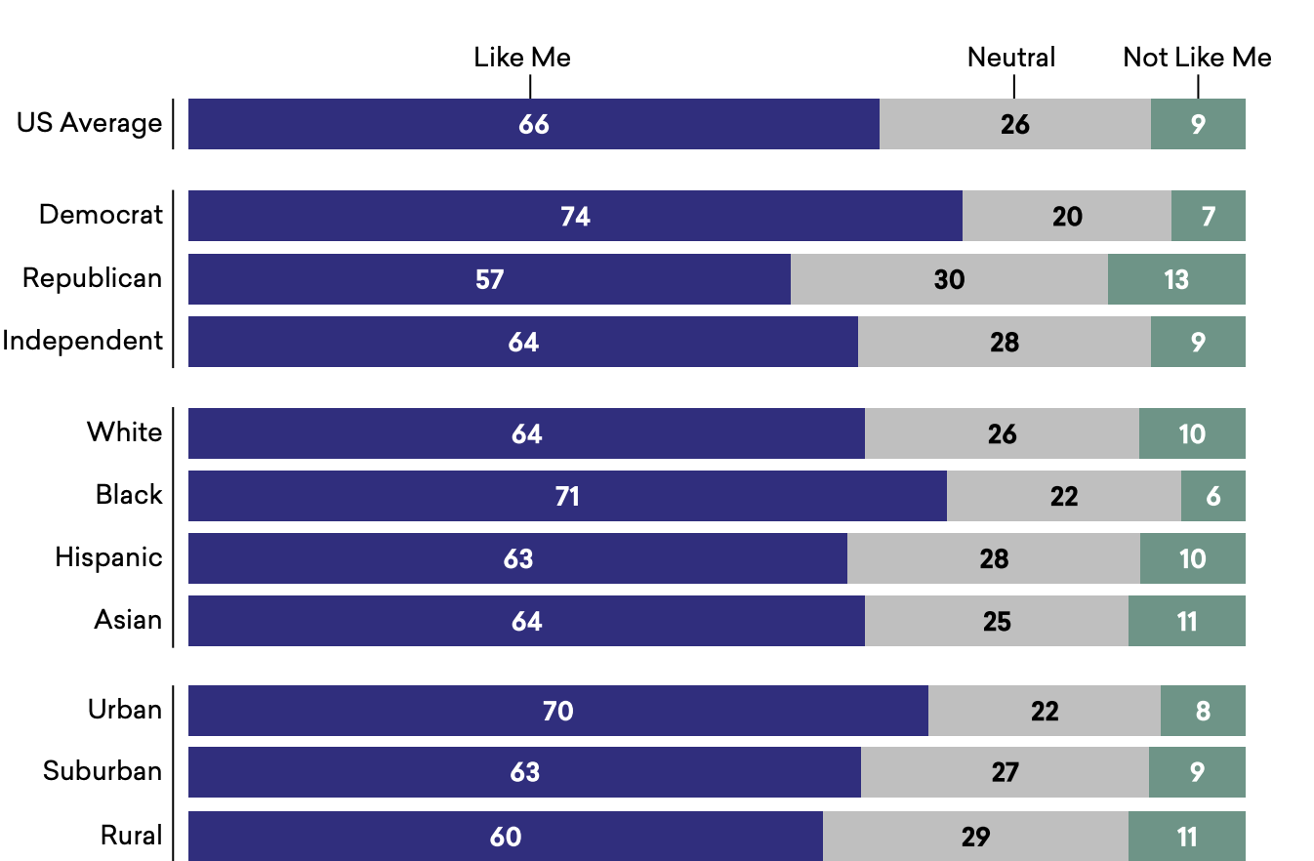

New Pluralists has many opportunities for impact. For example: most Americans want to connect more, across lines of difference
Race + Ethnicity
Politics
Class
Religion
66% of Americans believe they can learn a lot from connecting across difference
They feel more comfortable with connecting across race and class, and least comfortable with politics
This research is helping partners to identify how to strengthen connection in local communities, and how to overcome obstacles
“I can learn a lot from interacting with people whose backgrounds and viewpoints differ from my own.”
31

Slide 32
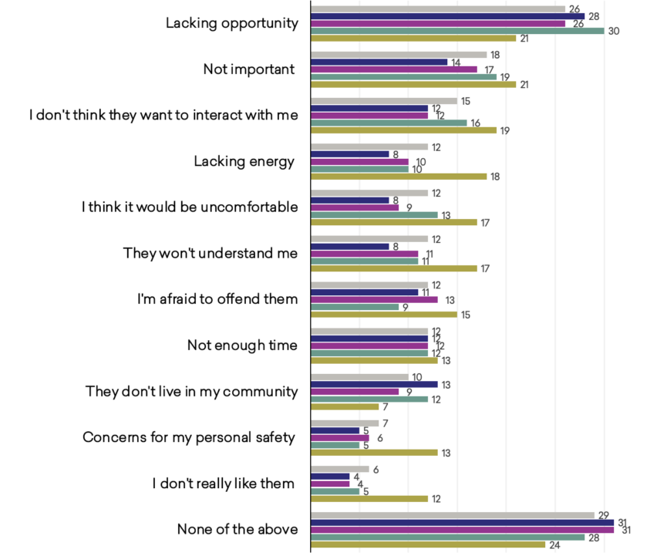
These efforts are more impactful when built on a strong evidence base – for example, that a lack of opportunity is the major barrier
Line of difference:
Average across lines of difference
Racial/ethnic
Religious
Socioeconomic
Political
Percents do not add up to 100% because participants could select multiple options. Wording of items has been edited for clarity.
Source: More in Common (2025). Survey of 4,522 US adults in 2024.
32

Slide 33
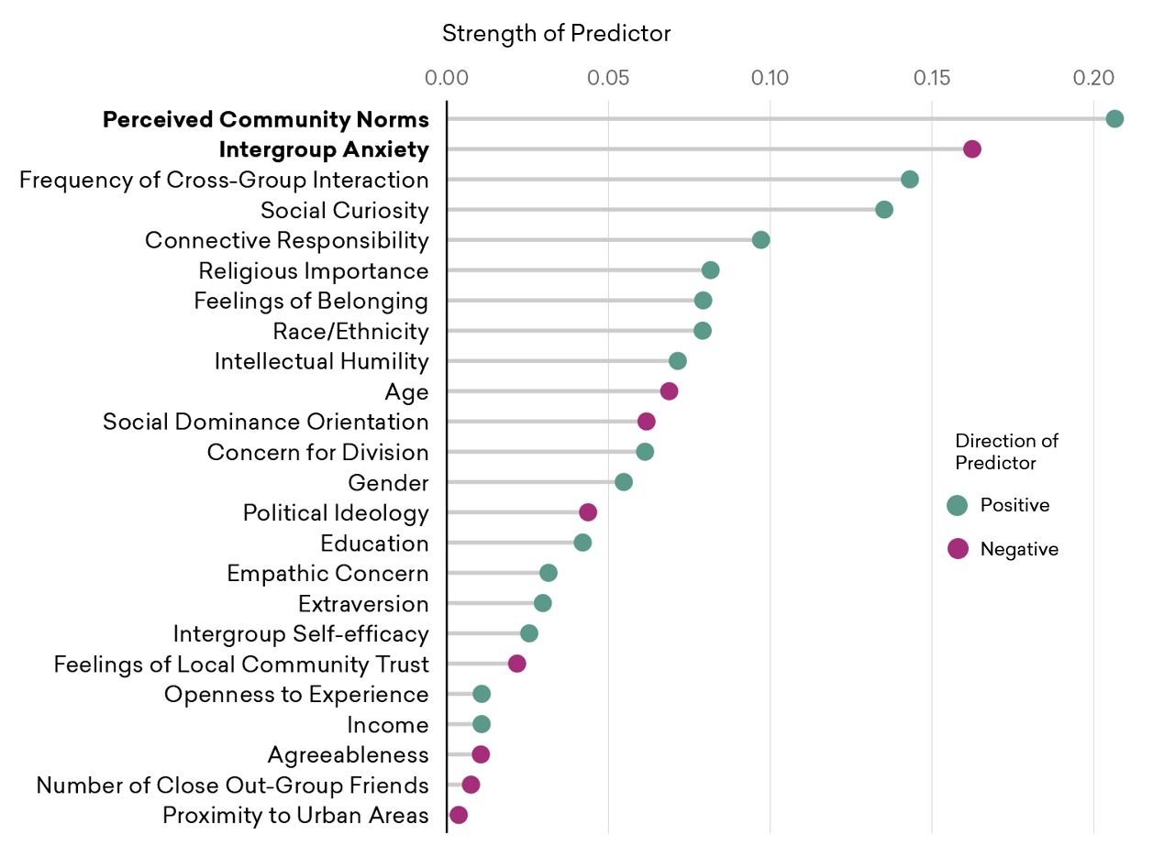
Impact is greater when initiatives harness key insights – e.g. building initiatives energized by the most powerful drivers of connection
Source: More in Common (2025). Survey of 4,522 US adults and a recontact survey of 2,009 US adults in 2024.
33

Slide 34
For example, partnering with StoryCorps we found that the activity to reduce social division that Americans are most likely to join is a conversation with someone from a different background or belief
%
Which of the following would you consider participating in to help reduce social division and bridge political divides in America, if any? Select all that apply.
Survey: n=2,000 adult US citizens from June 6 to June 10, 2022. The margin of error (adjusted for weighting) is +/- 2.2 for the US average and higher for subgroups.
Notes:
Asked about various bridge building initiatives. Attending a dinner, join a conversation. Conversation was most interesting to Americans.

Slide 35

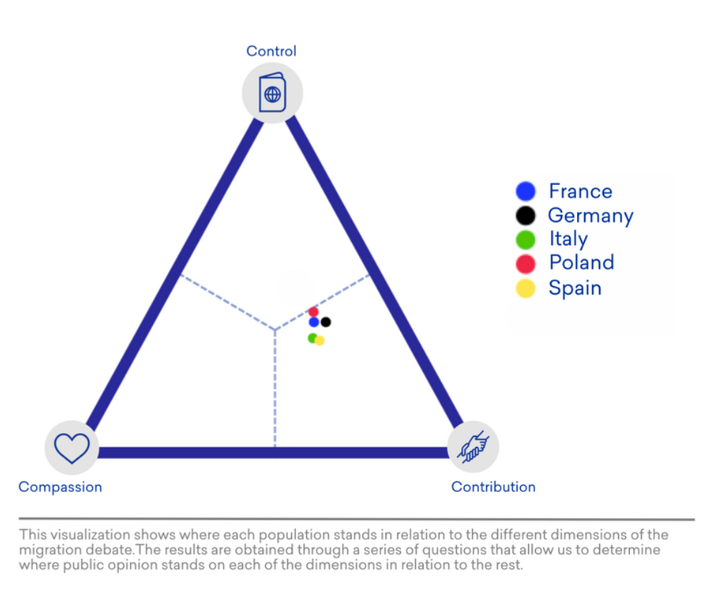
Europe
The Three Cs model of immigration attitudes
Understanding how politicians and civil society can rebuild consent and confidence for immigration policy
May 2026
Nordisk Stadsmissions konferens

Slide 36
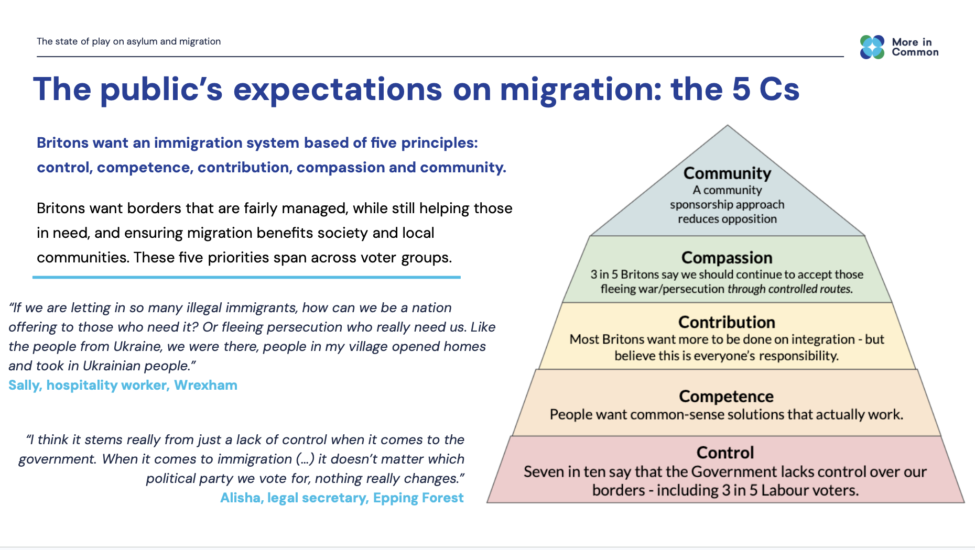
Great Britain

Slide 37
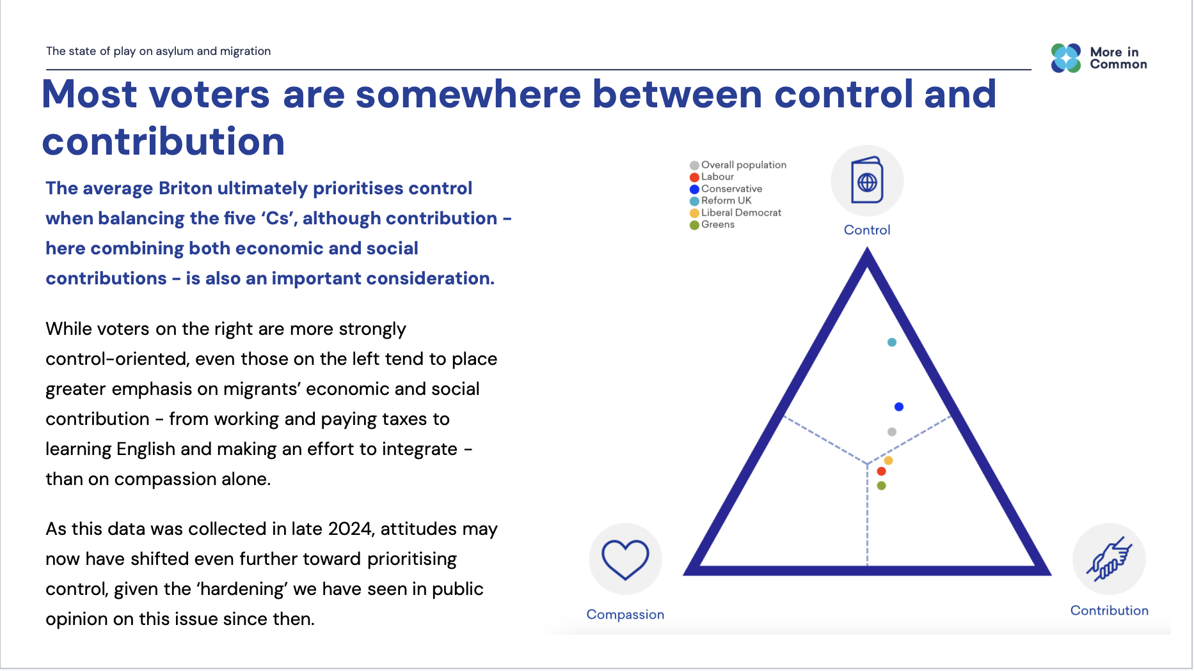
Great Britain

Slide 38
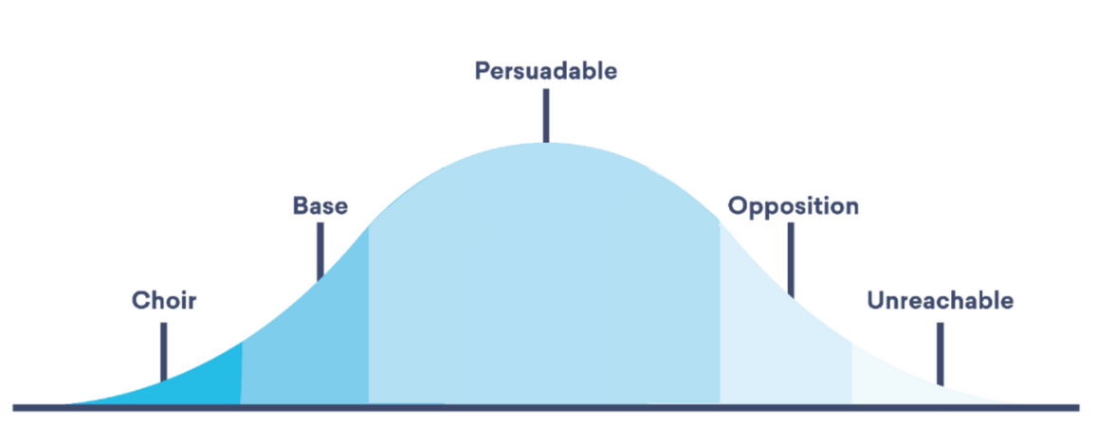
Europe
Helping leaders in Europe deal with changing attitudes on climate and developing a more ‘persuadables’ focused strategy on energy and the cost of living
May 2026
Nordisk Stadsmissions konferens

Slide 39
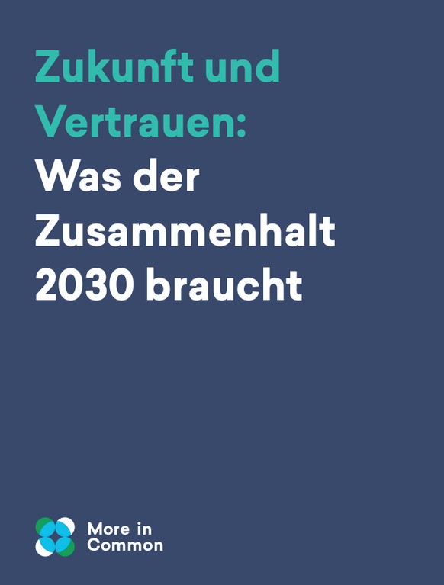
Germany
Helping leaders with long-term thinking on cohesion
The German Chancellor’s commissioned us to help develop their vision for cohesion through to 2030:
  Germany faces challenges to societal cohesion, including perceived polarisation, infrastructure issues, and socioeconomic inequalities. However, in many ways German society has underlying resilience.
  These threats are especially pronounced for the ‘Invisible Third’ of the population, identified in More in Common’s mapping of Germans’ value. They are marked out by lower trust, a lower sense of agency, higher loneliness, and feeling disrespected by others.
  To help focus future efforts, we identified 17 longer-term factors including improved infrastructure, a more constructive debate about immigration, a more effectively functioning social security system
  The report identified as a priority Germans’ confidence about the direction of their country and their role in the world
May 2026
Nordisk Stadsmissions konferens

Slide 40
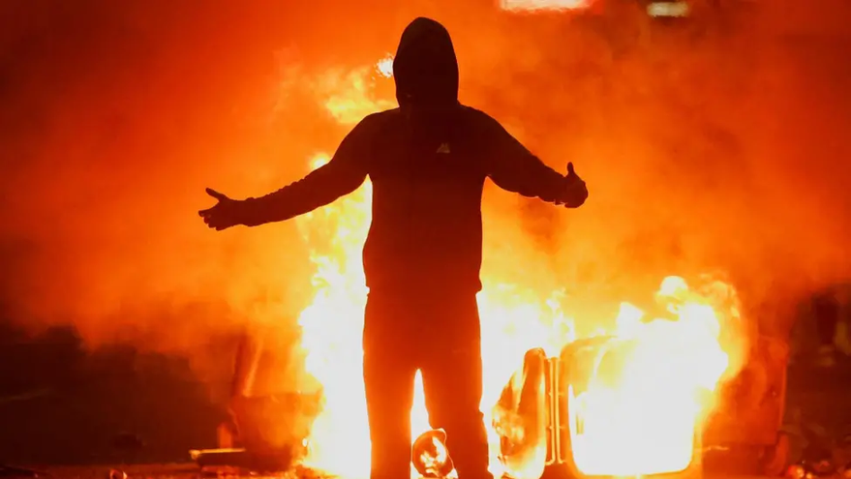
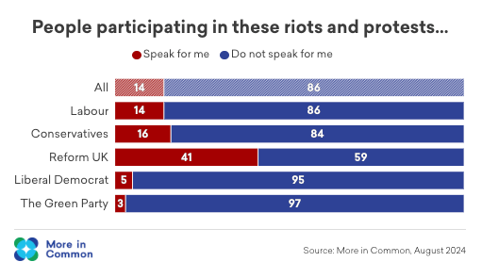
United Kingdom
Rapid response thought partner following riots
More in Common’s rapid response function to elevate the voices of a broader group of Britons in response to the 2024 riots.
There has led to ongoing work with the government and key partners around the basket of goods need in local areas to more effectively deal with the causes of the riots and broader cohesion breakdown.
Currently working with partners in Northern Ireland to understand how funders can better respond to rising racist violence including racist rioting earlier this summer.
May 2026
Nordisk Stadsmissions konferens

Slide 41
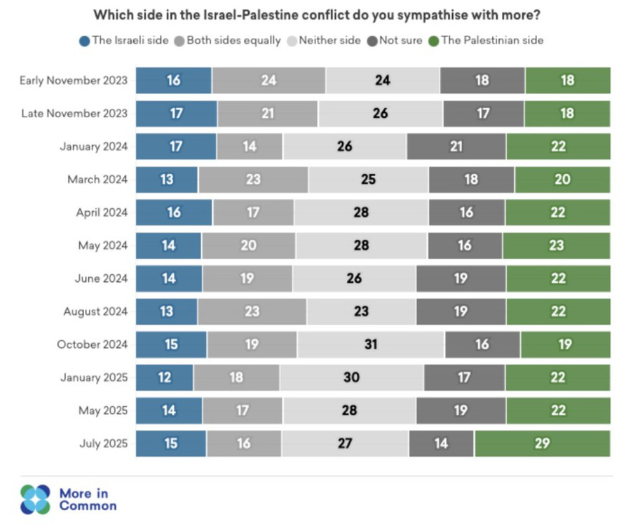
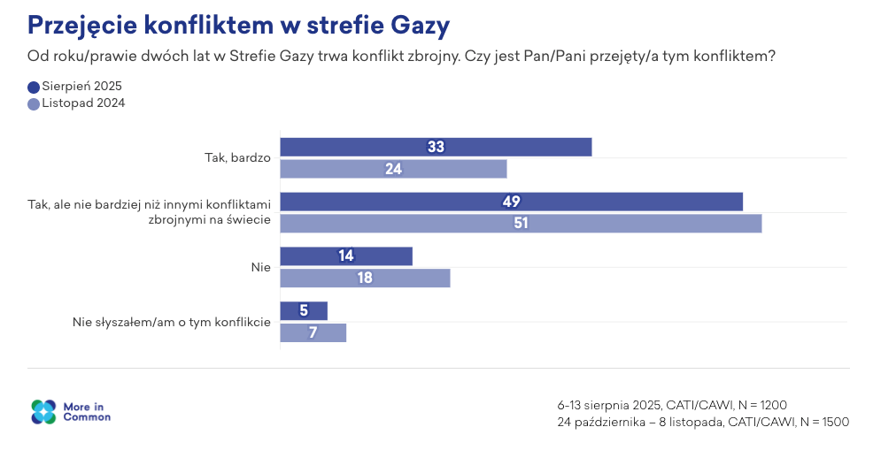
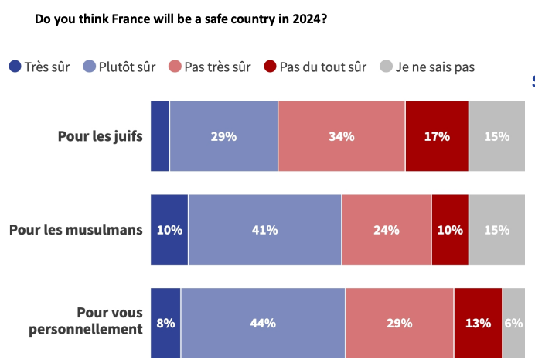
Tracking attitudes in Britain
UK, France and Poland
Helping leaders navigate the implications of the war in Gaza
May 2026
Nordisk Stadsmissions konferens

Slide 42
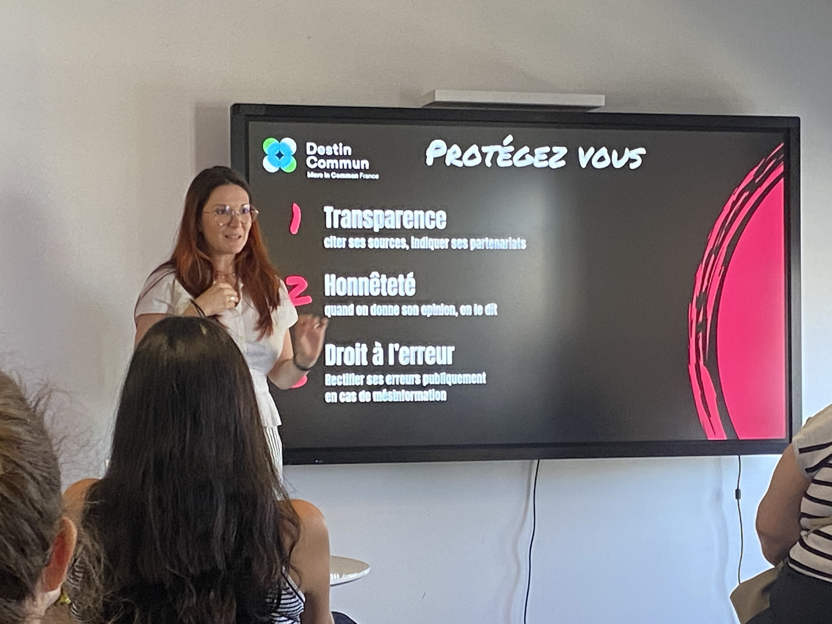
France
Training social media influencers on disinformation
Partnership with UMICC (Professional Union of Online Influencers) and Fake Off (network of journalists dedicated to media literacy) - several participants with following of more than 1 million
Training provided on audience insights and our different groups of segments in France
Part of More in Common’s broader stream of work tackling mis/disinformation
May 2026
Nordisk Stadsmissions konferens

Slide 43
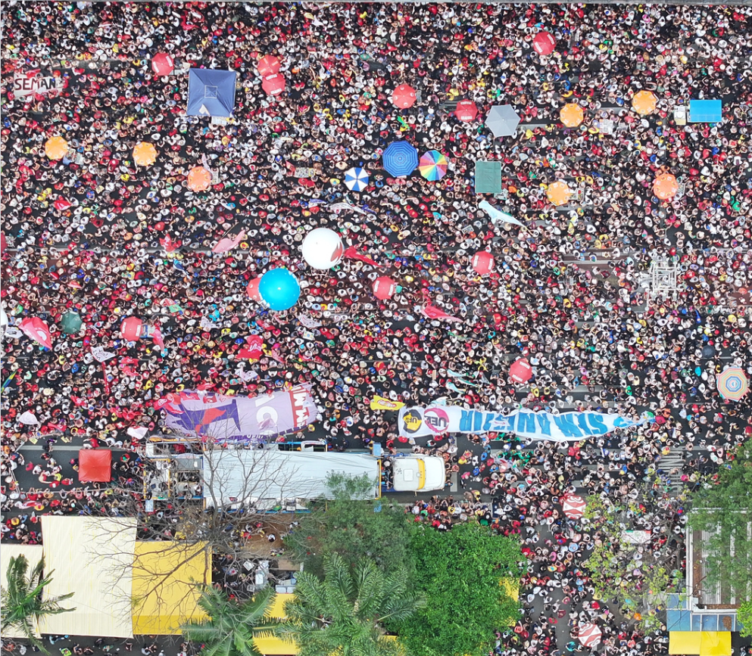
Brazil
Employing drone technology and AI to provide trustworthy crowd estimates when official estimates are exaggerated
May 2026
Nordisk Stadsmissions konferens

Slide 44
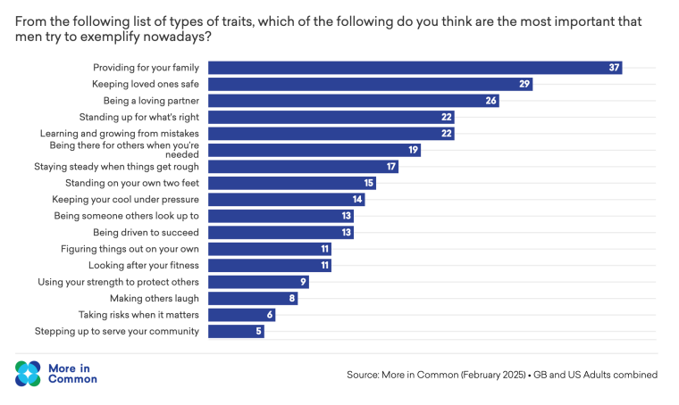
UK, US, Ireland
Working to build resilience among boys and young men, by partnering with leading mens’ health groups to find positive ways to talk about masculinity
May 2026
Nordisk Stadsmissions konferens

Slide 45
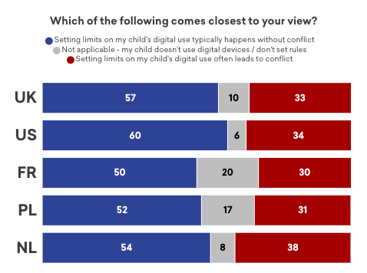
UK, US, Poland, Netherlands and France
Helping parent and tech groups to understand and engage parents around smartphones and online safety
Source: Parents Talk Online Safety, October 2025
May 2026
Nordisk Stadsmissions konferens

Slide 46
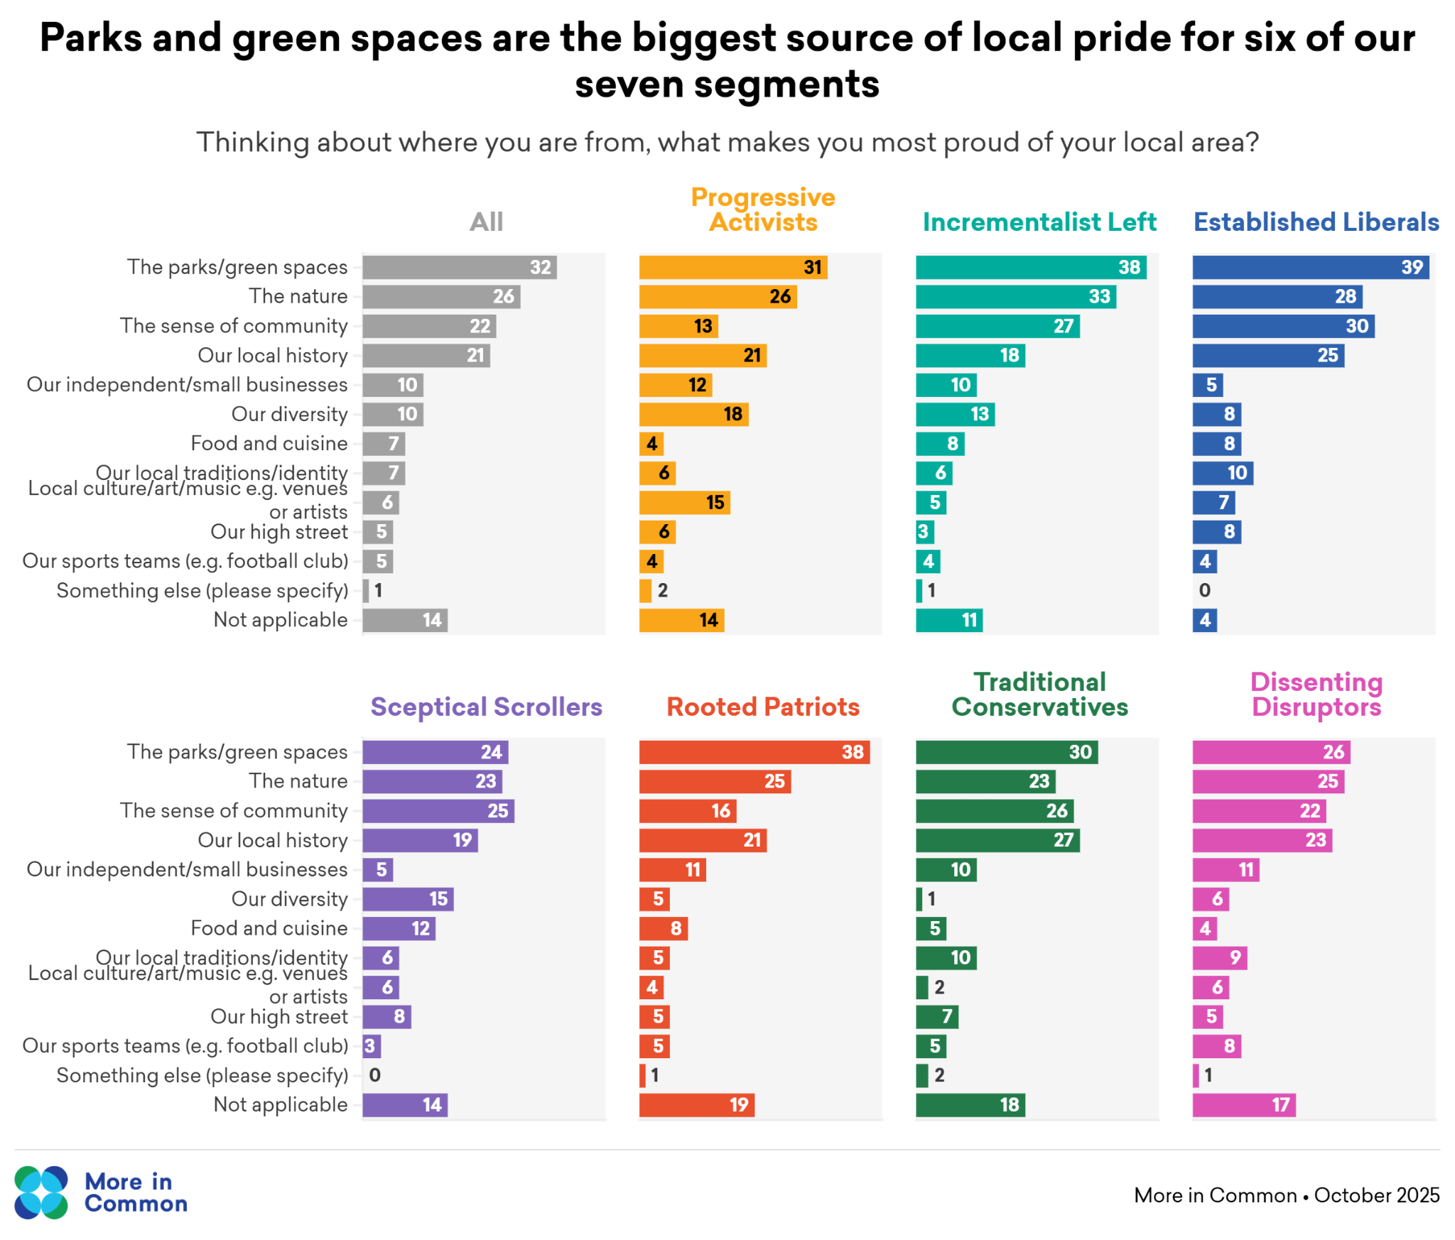

GB
Demonstrating how green spaces foster local pride – and
are vital to wellbeing
May 2026
Nordisk Stadsmissions konferens

Slide 47
3
Reflections on how civil society can
effectively meet this moment

Slide 48
1
A people-centric foundation: Prioritise interventions which can reach the ‘Invisible Third’ or ‘Exhausted Majority’ rather than the usual suspects

Slide 49
2
Acknowledge the upstream: Recognise that individual interventions or projects are shaped by headwinds and upstream challenges.

Slide 50
3
Value risk-taking: develop a risk appetite that fits the context - it is not a time for caution.

Slide 51
4
Value diversity of thought: engage partners who will disagree and ensure solutions are drawn from range of backgrounds and life experiences

Slide 52
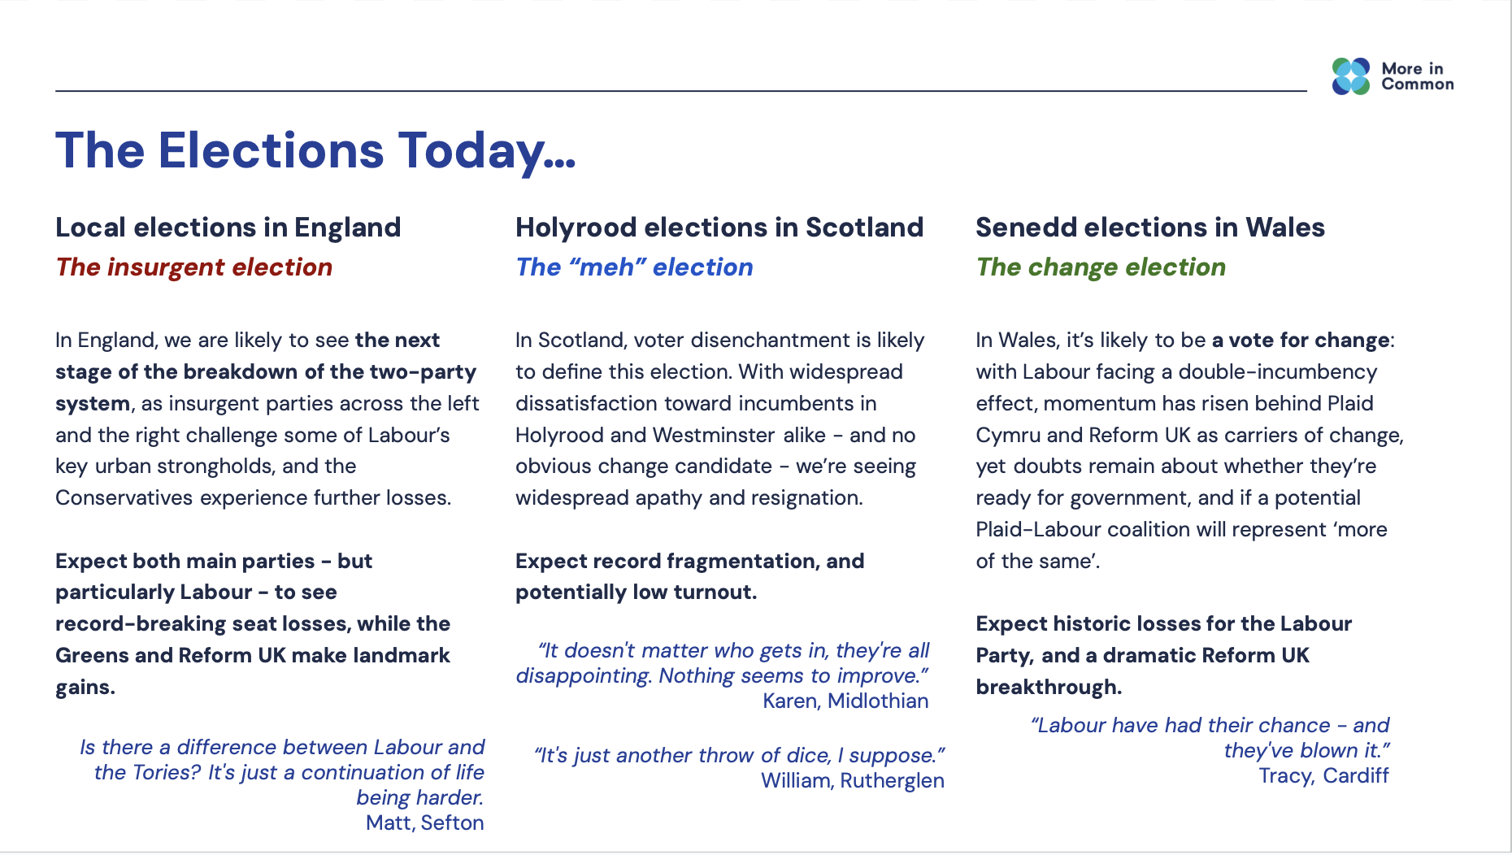

Slide 53

Archie Herrick
Reseacher
archie@moreincommon.com

